Slide 1
Air Quality Index Forecast - Mumbai
Time Series Project

Slide 2
Project Overview
The Air Quality Index (AQI) is a measure of how polluted the air is in a particular location. It is calculated based on the concentrations of several air pollutants, including particulate matter (PM2.5 and PM10), ozone (O3), nitrogen dioxide (NO2), and sulfur dioxide (SO2). The AQI is designed to provide a simple and standardized way to communicate the air quality to the public, and to help people make informed decisions about their activities and exposure to air pollution.
By monitoring and reporting the AQI, government agencies, businesses, and individuals can take appropriate actions to protect public health and the environment.
Moreover as reported in the NY Times article, India’s Air Pollution Rivals China’s as World’s Deadliest it has been found that India's air pollution is deadlier than even China's.

Slide 3

Data
The Data is gotten from the official AQI site and Kaggle, we are using data for 26 Indian Cities from 2015-2020 having 29531 records.
We noticed that there is lots of missing values in few of the variables, which is then made zero.
We have daily and hourly city data.
Cities used: Ahmedabad, Aizawl, Amaravati, Amritsar, Bengaluru, Bhopal, Brajrajnagar, Chandigarh, Chennai, Coimbatore, Delhi, Ernakulam, Gurugram, Guwahati, Hyderabad, Jaipur, Jorapokhar, Kochi, Kolkata, Lucknow, Mumbai, Patna, Shillong, Talcher, Thiruvananthapuram, Visakhapatnam
Class | Group A | Group B
Class 1 | 82 | 95
Class 2 | 76 | 88
Class 3 | 84 | 90

Slide 4
Variables Include:
Date - daily readings between 2015 and 2020
PM2.5 - Particulate Matter 2.5-micrometer in ug / m3
PM10 - Particulate Matter 10-micrometer in ug / m3
NO - Nitric Oxide in ug / m3
NO2 - Nitric Dioxide in ug / m3
NOx - Any Nitric x-oxide in ppb
NH3 - Ammonia in ug / m3
CO - Carbon Monoxide in mg / m3
SO2 - Sulphur Dioxide in ug / m3
O3 - Ozone in ug / m3
Benzene - Benzene in ug / m3
Toluene - Toluene in ug / m3
Xylene - Xylene in ug / m3
AQI - Air Quality Index
AQI Bucket - Air Quality Index Bucket (ranging from 'very poor' to 'good')

Slide 5
Analysis
Tools
Models
Excel
Python
SARIMA
Testing different versions of the models to get the get fit

Slide 6
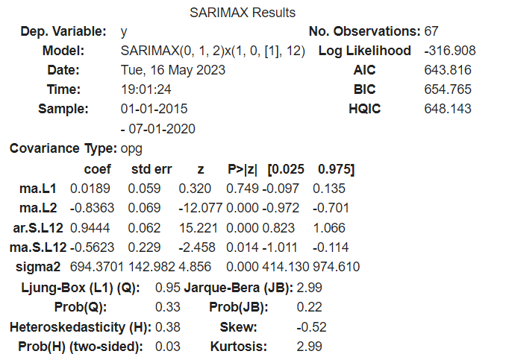
Using Auto Arima
Making use of Auto Arima to get value of p,d,q and P,D,Q and m for SARIMA

Slide 7
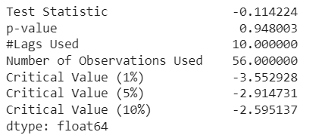
Using Augmented Dicky Fuller

Slide 8
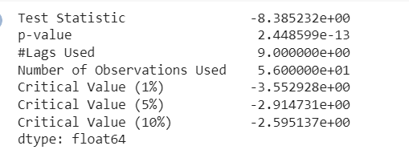
Taking Lag 1 to make data Stationary

Slide 9
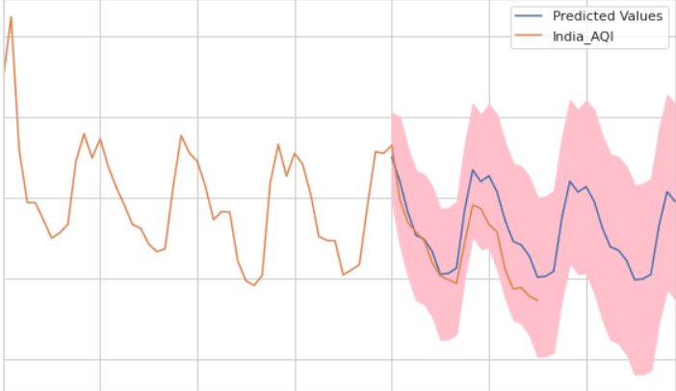
Forecasting based on the trained model

Slide 10
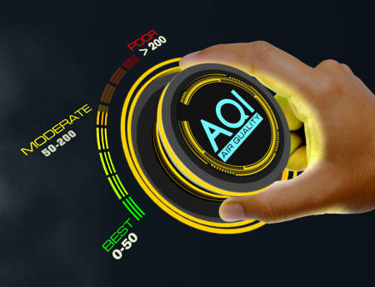
Thank you!
Team Members:
Drishti Chulani
Ovi Jadhav
Sahil Raorane

